Slide 1

CERTIFICATE III IN AUTOMOTIVE REPAIR & MAINTENANCE
SUBJECT: VEHICLE MAINTENACE AND REPAIR
By Ibrahim siraj
Maldives polytechnic

Slide 2
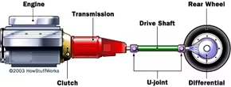
VEHICLE MAINTENACE AND REPAIR
Chapter 10 Inspection and Service Transmission
A Car Transmission System
Purpose of the transmission system
The purpose of a vehicle transmission system is to transfer power from the engine to the driving wheels, managing speed and torque through gear ratios to ensure efficient movement. It allows the engine to operate within an optimal RPM range, providing high torque for starting/climbing and lower torque for high-speed
By Ibrahim siraj
Maldives polytechnic

Slide 3
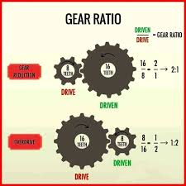
VEHICLE MAINTENACE AND REPAIR
Chapter 10 Inspection and Service Transmission
A Car Transmission System
How the Torque and Speed change
Torque and speed generally have an inverse relationship in mechanical systems: as torque increases, speed decreases, and vice versa, provided power remains constant (P = T times x ώ omega). Mechanical systems like gears, belts, or pulleys are used to manipulate this trade-off, where a higher gear ratio increases torque but reduces speed.
By Ibrahim siraj
Maldives polytechnic

Slide 4
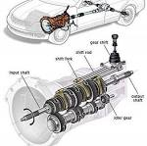
VEHICLE MAINTENACE AND REPAIR
Chapter 10 Inspection and Service Transmission
A Car Transmission System
Why Transmission system needed for vehicle
Internal combustion engines have a narrow useful RPM range
A transmission system is essential for a vehicle to transfer engine power to the wheels efficiently, adapting to varied speeds and loads. By using gears, it allows the engine to operate within its optimal RPM range—providing high torque for acceleration and low RPMs for high-speed cruising—without stalling or overworking
The Solution: Transmissions match engine power output to driving conditions.
Starting: High torque, low vehicle speed.
Cruising: Low torque, high vehicle speed.
Neutral/Reverse: Allows the car to idle stationary or back up.
By Ibrahim siraj
Maldives polytechnic

Slide 5
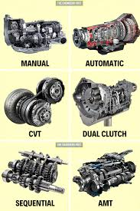
VEHICLE MAINTENACE AND REPAIR
Chapter 10 Inspection and Service Transmission
A Car Transmission System
Common Types of Transmission systems
Manual, Automatic, CVT (Continues Variable Transmission), DCT (Dual-Clutch Transmission ), Sequential Transmission and Auto Manual Transmission
Manual Transmission (MT)
A gearbox where the driver manually selects gear ratios
Automatic Transmission (AT)
an automatic transmission that provides an infinite range of gear ratios, rather than fixed steps
Continues Variable Transmission (CVT)
an automatic transmission that uses a system of pulleys and a metal belt to provide an infinite range of gear ratios rather than fixed, stepped gears.
Dual-Clutch Transmission (DCT)
an advanced automatic gearbox that uses two separate clutches to manage odd and even gears independently
Sequential Transmission
type of non-synchronous gearbox—common in motorcycles and race cars—that allows for rapid gear shifts by requiring the driver to select the next or previous gear in a strict linear sequence (1-2-3-4-5-6), preventing skipped gears
Auto Manual Transmission (AMT)
type of transmission that uses a conventional manual gearbox's mechanical setup but automates the clutch and gear-shifting process via electronic sensors and actuators.
By Ibrahim siraj
Maldives polytechnic

Slide 6
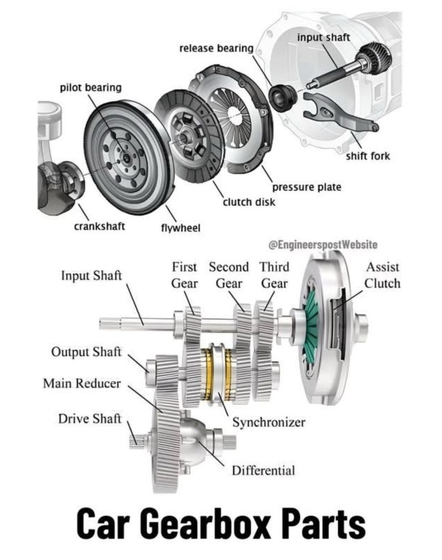
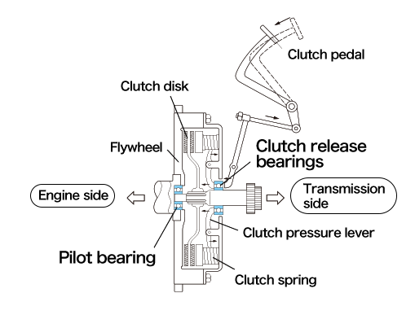
VEHICLE MAINTENACE AND REPAIR
Chapter 10 Inspection and Service Manual Transmission
Basic Parts of a Manual Transmission
Clutch
Gearbox
Shafts
Gears
Shift Mechanism
Clutch: Connects and disconnects the engine from the transmission, allowing you to change gears without grinding
By Ibrahim siraj
Maldives polytechnic

Slide 7
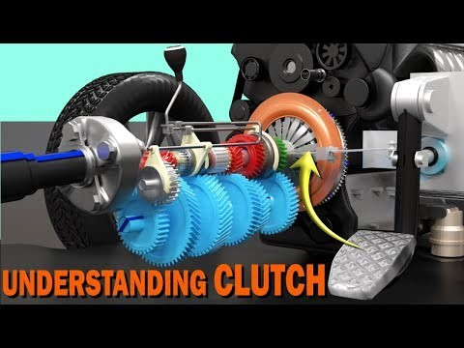
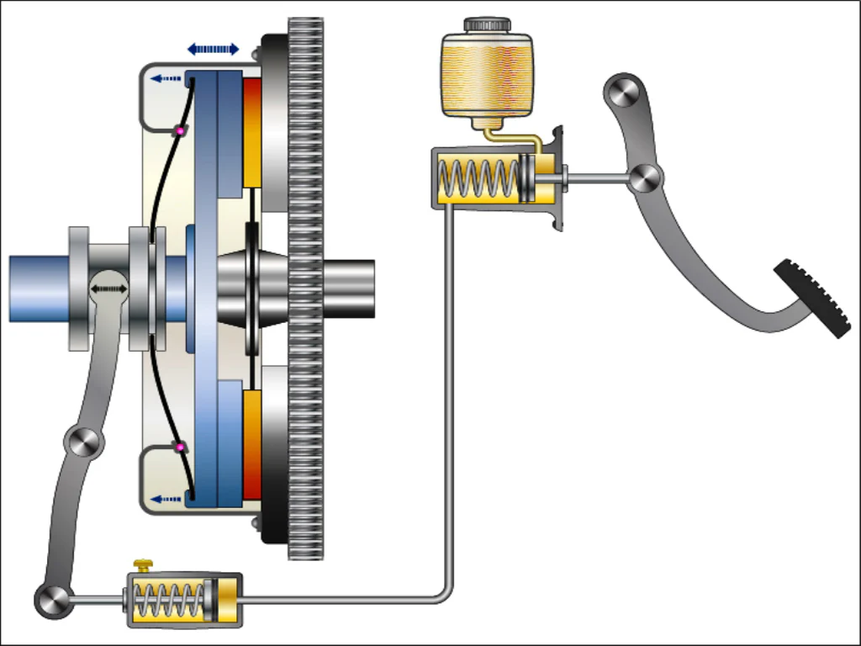
VEHICLE MAINTENACE AND REPAIR
Chapter 10 Inspection and Service Manual Transmission
Basic Parts of a Manual Transmission
Clutch: Connects and disconnects the engine from the transmission, allowing you to change gears without grinding. Located between the engine and gearbox, it enables smooth gear changes and allows the vehicle to stop without stalling by interrupting power flow to the
By Ibrahim siraj
Maldives polytechnic

Slide 8
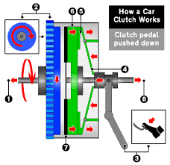
VEHICLE MAINTENACE AND REPAIR
Chapter 10 Inspection and Service Manual Transmission
Basic Parts of a Manual Transmission
Clutch: Construction
Engaged (Pedal Up): The pressure plate forces the clutch plate against the spinning flywheel, locking the engine and transmission together, allowing the car to move
Disengaged (Pedal Down): You press the pedal, pushing the release bearing against the spring. This lifts the pressure plate, separating the clutch disc from the flywheel and stopping power transmission
By Ibrahim siraj
Maldives polytechnic

Slide 9
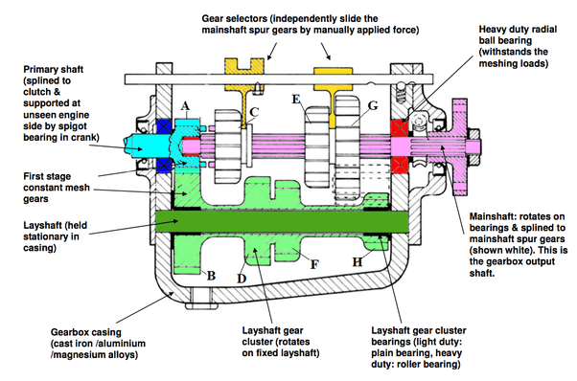
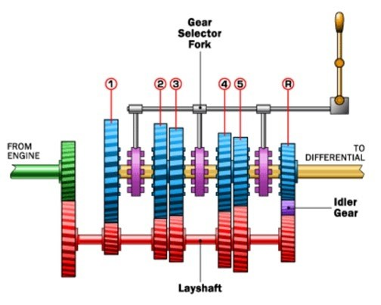
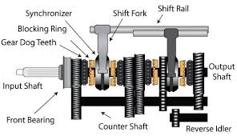
VEHICLE MAINTENACE AND REPAIR
Chapter 10 Inspection and Service Manual Transmission
Basic Parts of a Manual Transmission
Gearbox: The case that houses the internal components, including the gears, shafts, and bearings
Types of Gear Box
Sliding mesh type
Constant mesh type
Synchromesh type
the earliest, simplest type of manual transmission,, where gear ratios are changed by physically sliding gears along a splined shaft to mesh with specific gears on a countershaft.
type of manual transmission where all forward gears are constantly in mesh (engaged) with their counterparts on parallel shafts
type of modern manual transmission that uses specialized "synchronizer" devices to align the speeds of gears before they engage, resulting in smooth, silent, and effortless shifting.
By Ibrahim siraj
Maldives polytechnic

Slide 10
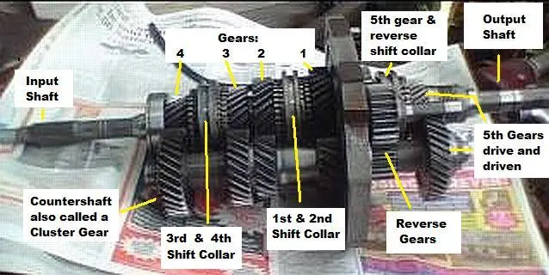
VEHICLE MAINTENACE AND REPAIR
Chapter 10 Inspection and Service Manual Transmission
Basic Parts of a Manual Transmission
Shafts:
Input Shaft: Receives power from the engine via the clutch and flywheel.
Output Shaft: Transfers power from the transmission to the wheels.
Countershaft (or Layshaft): A shaft that holds gears and transfers power between the input and output shafts
By Ibrahim siraj
Maldives polytechnic

Slide 11
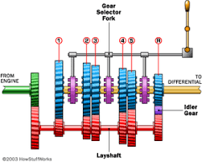
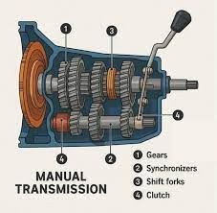
VEHICLE MAINTENACE AND REPAIR
Chapter 10 Inspection and Service Manual Transmission
Basic Parts of a Manual Transmission
Gears: Different-sized gears are mounted on the shafts, and their engagement at various ratios determines the vehicle's speed and torque.
Shift Mechanism:
Gear Shift Lever (Stick Shift): The lever the driver uses to select a gear.
Shift Forks: Move the synchronizer rings to engage the chosen gear.
Synchronizers: Devices that match the speed of the gears and the collar before they lock together, preventing grinding and ensuring smooth shifting
By Ibrahim siraj
Maldives polytechnic

Slide 12
VEHICLE MAINTENACE AND REPAIR
Chapter 10 Inspection and Service Manual Transmission
How it works
Depress the clutch: The driver pushes the clutch pedal down to disengage the engine from the transmission.
Move the shift lever: The driver moves the shift lever to the desired gear position.
Linkage moves the fork: The shift lever's movement activates the linkage to push the correct shift fork.
Collar engages the gear: The shift fork pushes the synchronizer collar, which slides along the shaft.
Synchronization: Before locking, the synchronizer ring (part of the collar) frictionally matches the speed of the free-spinning gear to the speed of the output shaft.
Gear engagement: Once the speeds are synchronized, the collar slides further to lock onto the gear's teeth, making the gear a single unit with the output shaft.
Release the clutch: The driver releases the clutch to transfer power from the engine through the newly selected gear
By Ibrahim siraj
Maldives polytechnic

Slide 13
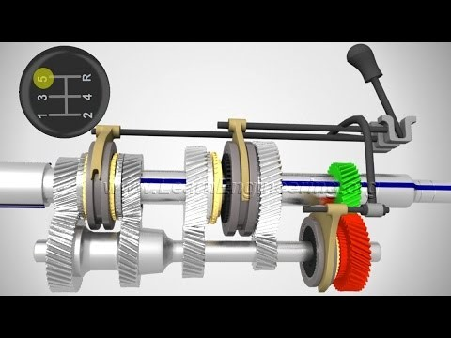
VEHICLE MAINTENACE AND REPAIR
Chapter 10 Inspection and Service Manual Transmission
Manual Transmission
By Ibrahim siraj
Maldives polytechnic

Slide 14
VEHICLE MAINTENACE AND REPAIR
Chapter 10 Inspection and Service Manual Transmission
Manual Transmission Gear Ratios
Gear Ratio Principles
Calculation: A gear ratio is calculated by dividing the number of teeth on the driven gear by the number of teeth on the driving gear (Ratio = Driven ÷ Drive).
Torque vs. Speed: A gear ratio greater than 1:1 is a gear reduction (underdrive), which increases torque but decreases speed. A gear ratio less than 1:1 is an overdrive, which increases speed but decreases torque.
Overall Ratio: The final overall gear ratio for the wheels includes both the transmission's individual gear ratio and the final drive ratio in the differential. The overall ratio for a specific gear is the product of its transmission ratio and the final drive ratio.
By Ibrahim siraj
Maldives polytechnic

Slide 15
VEHICLE MAINTENACE AND REPAIR
Chapter 10 Inspection and Service Manual Transmission
Typical Gear Ratios (5-Speed Manual)
Typical manual transmissions feature a progression of gear ratios designed to optimize performance across different driving conditions. Below are common examples:
Gear | Typical Ratio | Purpose
1st Gear | ~3.0:1 to 4.0:1 | Provides maximum torque for starting from a standstill or climbing steep hills.
2nd Gear | ~1.8:1 to 2.5:1 | Offers a balance of torque and speed for moderate acceleration.
3rd Gear | ~1.2:1 to 1.5:1 | Suitable for city driving and maintaining speed on flat roads.
4th Gear | ~1.0:1 (Direct Drive) to 1.2:1 | Often a 1:1 direct drive ratio in 4-speed or some 5-speed transmissions, where the input and output shafts spin at the same speed.
5th Gear (Overdrive) | ~0.7:1 to 0.9:1 | An overdrive gear designed for high speeds with reduced engine RPM, improving fuel efficiency during highway cruising.
Reverse | ~3.0:1 to 4.0:1 | Uses an idler gear to reverse the direction of rotation, offering high torque for moving backward.
Final Drive | ~3.5:1 to 4.5:1 | An additional reduction in the differential that multiplies the transmission's output torque before it reaches the wheels
By Ibrahim siraj
Maldives polytechnic

Slide 16
VEHICLE MAINTENACE AND REPAIR
Chapter 10 Inspection and Service Manual Transmission
Typical Gear Ratios (5-Speed Manual)
Manual transmissions are most commonly found in sports cars, enthusiast vehicles, and trucks, though they are becoming less common in new models. Examples include the Ford Mustang, Mazda Miata, Subaru BRZ, Toyota GR86, Toyota Tacoma, and Jeep Wrangler. They offer drivers a greater sense of control over the vehicle
Sports cars and enthusiast vehicles
Acura: Integra, Integra Type S
BMW: M2, M3, M4, Z4
Cadillac: CT4-V, CT5-V
Honda: Civic Si, Civic Type R
Lotus: Emira
Mazda: 3 Hatchback, Miata
Nissan: Z
Porsche: 718 Boxster and Cayman, 911
Subaru: BRZ, WRX
Toyota: GR86, GR Corolla, GR Supr
By Ibrahim siraj
Maldives polytechnic

Slide 17
VEHICLE MAINTENACE AND REPAIR
Chapter 10 Inspection and Service Manual Transmission
Typical Gear Ratios (5-Speed Manual)
Gear Change Approx. Speed Tachometer RPM Upshifting
1 st – 2 nd 15 mph 2,000 – 3,000
2 nd – 3 rd 25 mph 2,500 – 3,500
3 rd – 4 th 40 mph 2,500 – 3,500
4 th – 5 th 50 mph 2,500 – 3,500
Downshifting
5 th – 4 th 40 mph 2,000
4 th – 3 rd 30 mph 2,000
3 rd – 2 nd 20 mph 2,000
2 nd – 1 st 10 mph 1,500
By Ibrahim siraj
Maldives polytechnic

Slide 18
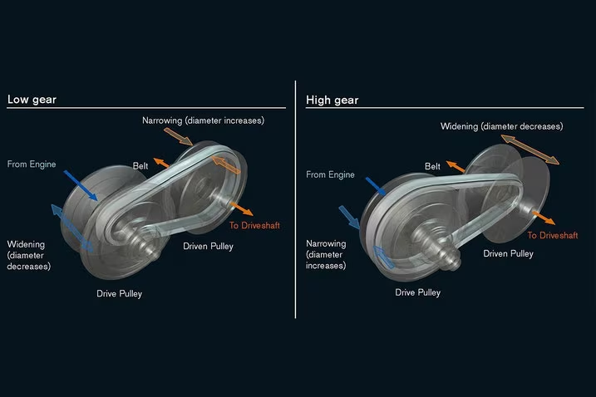
VEHICLE MAINTENACE AND REPAIR
Chapter 10 Inspection and Service Transmission
A Car Transmission System
CVTs are most common in passenger cars, hybrid vehicles, scooters
Continues Variable Transmission (CVT)
An automatic transmission that uses a system of pulleys and a metal belt to provide an infinite range of gear ratios rather than fixed, stepped gears.
Infinite Gear Ratios: Unlike traditional automatics (e.g., 6-speed, 10-speed), a CVT can shift seamlessly between an infinite number of ratios.
How it Works: It uses two V-shaped pulleys with a belt running between them. As the pulley sides move closer or farther apart, the effective diameter changes, altering the gear ratio
Optimal Performance: A CVT allows the engine to operate at its most efficient speed (RPM) regardless of vehicle speed, which is ideal for fuel consumption
By Ibrahim siraj
Maldives polytechnic

Slide 19
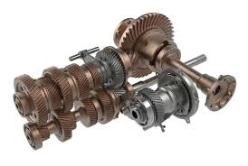
VEHICLE MAINTENACE AND REPAIR
Chapter 10 Inspection and Service Transmission
A Car Transmission System
Sequential Transmission
type of non-synchronous gearbox—common in motorcycles and race cars—that allows for rapid gear shifts by requiring the driver to select the next or previous gear in a strict linear sequence (1-2-3-4-5-6), preventing skipped gears
Linear Selection: The gear selector moves in a forward-and-backward motion (often push for downshift, pull for upshift) rather than an "H" pattern
Dog Clutches: Unlike standard manual gearboxes that use synchromesh, sequential gearboxes generally use "dog rings" or "dog clutches". These allow for faster, more direct engagement of gears
Motorcycle Setup: On a motorcycle, a foot lever is used to move through gears sequentially
By Ibrahim siraj
Maldives polytechnic

Slide 20
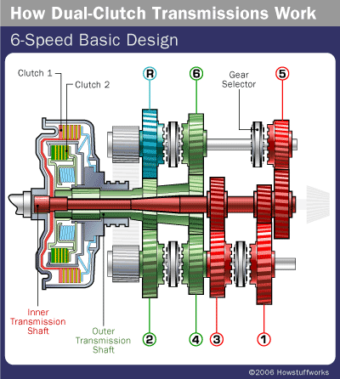
VEHICLE MAINTENACE AND REPAIR
Chapter 10 Inspection and Service Transmission
A Car Transmission System
Dual-Clutch Transmission (DCT)
An advanced, automated gearbox that uses two separate clutches—without a clutch pedal—to manage odd and even gears independently. This design enables lightning-fast gear changes, improved fuel efficiency, and a sportier, more responsive driving experience compared to traditional automatic transmission
Two Clutches: One clutch handles odd gears (1, 3, 5, 7), while the other manages even gears (2, 4, 6) and reverse.
Pre-selected Gears: While one gear is active, the system pre-selects the next gear, allowing for nearly instantaneous shifts (in milliseconds).
No Clutch Pedal: Despite using manual-style gears, the system is fully automatic, though many offer paddle shifters for manual control.
Performance & Efficiency: DCTs are favored for providing smooth, rapid acceleration and better fuel economy than traditional torque-converter automatics
By Ibrahim siraj
Maldives polytechnic

Slide 21
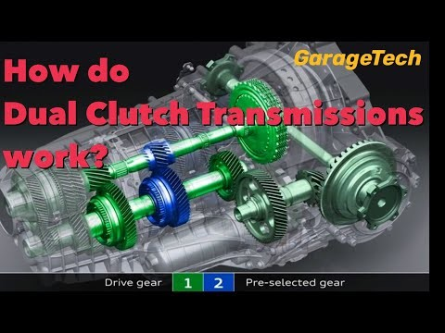
VEHICLE MAINTENACE AND REPAIR
Chapter 10 Inspection and Service Transmission
A Car Transmission System
Dual-Clutch Transmission (DCT)
An advanced, automated gearbox that uses two separate clutches—without a clutch pedal—to manage odd and even gears independently. This design enables lightning-fast gear changes, improved fuel efficiency, and a sportier, more responsive driving experience compared to traditional automatic transmission
By Ibrahim siraj
Maldives polytechnic

Slide 22
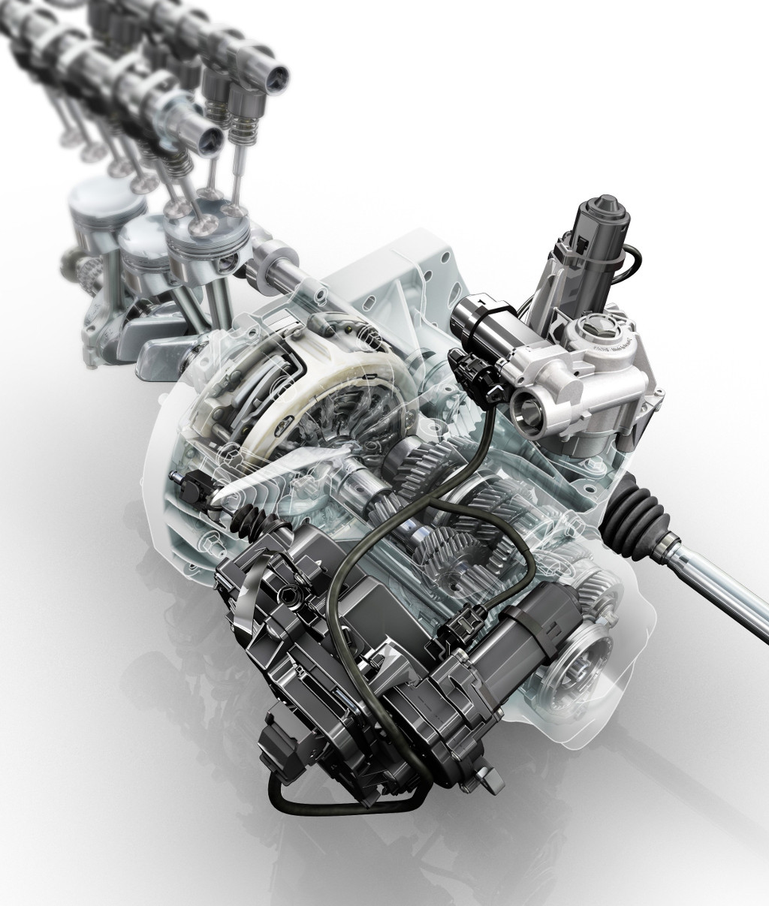
VEHICLE MAINTENACE AND REPAIR
Chapter 10 Inspection and Service Transmission
A Car Transmission System
Auto Manual Transmission system (AMT)
A hybrid system that uses a traditional manual gearbox's internal components but automates the clutch and gear shifting using ECU-controlled actuators. It offers the convenience of an automatic (no clutch pedal) with the fuel efficiency and lower cost of a manual.
No Clutch Pedal: The computer manages the clutch, simplifying driving, especially in traffic.
Manual Mode Option: Most AMTs allow the driver to manually select gears using a "+/-" gate on the shifter or paddle shifters.
Increased Efficiency: Generally more fuel-efficient than conventional automatic transmissions.
Shift Feel: Drivers may experience a slight pause or "jerkiness" during gear changes, as it mimics the pause of a manual transmission.
Use Cases: Frequently used in hatchbacks, SUVs, and commercial vehicles (like the Eaton Cummins Endurant) for its blend of cost-effectiveness and convenience.
By Ibrahim siraj
Maldives polytechnic

Slide 23
THANK YOU

